Slide 1
Ron’s Pathogen Meeting Presentation
A Ron Huebler Production

Slide 2
What Do I actually Do?

Slide 3
HOPS
The conda package broke due to a dependency changing…. Have to fix that somehow
Apparently many packages were affected, basically a repository changed, breaking pretty much half of conda…

Slide 4
DB Pipeline
Pretty much just testing all functions and writing….
When downloading from NCBI after a while I got following message
I got following error message: org.apache.commons.net.ftp.FTPConnectionClosedException: FTP response 421 received. Server closed connection.
Identify problem -> try a bugfix -> rerun -> pray to Dr. Thomas that the fix works
Notes:
-> rerun -> and pray to Dr. Thomas that the problem is fixed

Slide 5
What Did it look like
try(BufferedReader reader = new BufferedReader(new InputStreamReader(client.retrieveFileStream)) {
// Do something clever with my code
reader.close;
} catch (IOException io){
Io.print
}

Slide 6
What was the fix
try{
InputStream is =client.retrieveFileStream(fileName);
InputStreamReader in = new InputStreamReader(is);
BufferedReader reader = new BufferedReader(in);
// Still do Something clever
is.close
in.close
reader.close
}catch(ServerInterrupted Exception){
Restart FTP client
Print (how often was client restarted)
}

Slide 7
What was the Problem
You can stack input stream like Russian Doll
The close function SHOULD close all streams that go into a stream-> But apparently it doesn’t
Therefore we hit the maximum number of connections NCBI allows and the server blocked the IP Address for a while

Slide 8

16S Capture
Or your 16S/18S Capture array

Slide 9
Introduction
The capture array is based on 2016 SILVA database
598.470 taxa (22.913 Archaea, 513.121 Bacteria, 62.436 Eukaryota).
The probes are distributed across eight arrays (~1 million per array) which together result in a 4bp tiling.
Every array is an independent array with 32bp tiling, so if one array fails, it effects all parts of the taxonomy equally.
From the eight capture arrays an in solution array was established.

Slide 10
Introduction
16S/18S Capture data and shotgun data for a series of samples from Leipzig
human tissues spiked with a bacterial mock community
dissolution series for the mock community and blocking oligos
calculated the fraction of reads summarized under Bacteria for shotgun and capture data
Than calculate target efficiency by dividing FractionCap by FractionSG

Slide 11
Mock Community Composition
Acinetobacter baumannii | Listeria monocytogenes
Actinomyces odontolyticus | Neisseria meningitidis
Bacillus cereus | Propionibacterium acnes
Bacteroides vulgatus | Pseudomonas aeruginosa
Clostridium beijerinckii | Rhodobacter sphaeroides
Deinococcus radiodurans | Staphylococcus aureus
Enterococcus faecalis | Staphylococcus epidermidis
Escherichia coli | Streptococcus agalactiae
Helicobacter pylori | Streptococcus mutans
Lactobacillus gasseri | Streptococcus pneumoniae

Slide 12
Results Capture and Shotgun
 | Capture | Shotgun
Fraction 16S Bacteria | 0.77 | 0.05
Fraction 16S Vertebrata | 0.05 | 0.75
Fraction 16S Eukaryotes | 0.09 | 0.76

Slide 16
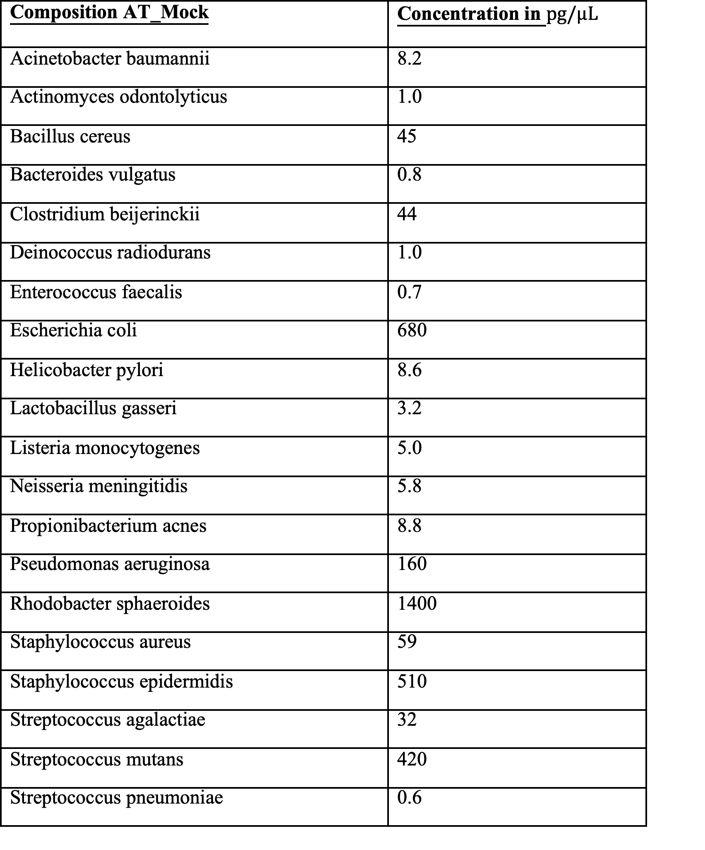

Slide 17
Correlation

Slide 18
The twilight Zone
AT.Mock.1.50.2 only had a few thousand reads for capture and shotgun
patient.2.AT failed for shotgun sequencing
According to Kay no excess of unknown adapters observed for the shotgun run
But there were issues with adapters(he had to use the reverse complement)

Slide 19
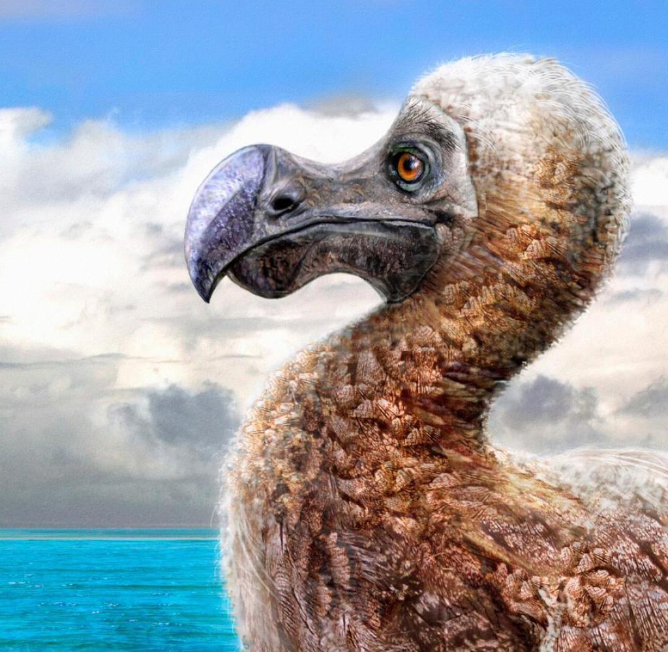
ToDos
Writing current results down
Correlation between original concentrations and number of assigned reads is very small
Probably needs a better solution

Slide 20
Notes:
Dilution sersies of Mock community

Slide 21
Notes:
Diltuion Series blocking oligos

Slide 22
Notes:
Human tissues

